Slide 1
Science versus Pseudoscience,
Opinions versus Arguments
Lecture in BMI199: What is Biomedical Informatics?
Sept 17, 2020 on-line, University at Buffalo
Werner CEUSTERS, MD
Departments of Biomedical Informatics and Psychiatry,
UB Institute for Healthcare Informatics,
Ontology Research Group, Center of Excellence in Bioinformatics and Life Sciences,
University at Buffalo, NY, USA

Slide 2
Class overview
Test Q2
Lecture

Slide 3
Science and research versus pseudoscience

Slide 4
Science and research
Research:
  studious inquiry or examination, especially investigation or experimentation aimed at:
  the discovery and interpretation of facts,
  revision of accepted theories or laws in the light of new facts, or at
  the practical application of such new or revised theories or laws.
Science:
  the pursuit and application of knowledge and understanding of the natural and social world following a systematic methodology based on evidence.
http://www.merriam-webster.com/dictionary/research
http://sciencecouncil.org/about-us/our-definition-of-science/

Slide 5
Science and research
Research:
  studious inquiry or examination, especially investigation or experimentation aimed at:
  the discovery and interpretation of facts,
  revision of accepted theories or laws in the light of new facts, or at
  the practical application of such new or revised theories or laws.
Science:
  the pursuit and application of knowledge and understanding of the natural and social world following a systematic methodology based on evidence.
http://www.merriam-webster.com/dictionary/research
http://sciencecouncil.org/about-us/our-definition-of-science/

Slide 6

Data generation and use
Science
Research
data
organization
model development
observation &
measurement
further R&D
(instrument and
study optimization)
add
verify
use
Δ = outcome
Generic
beliefs
application

Slide 7
Science and research
Research:
  studious inquiry or examination, especially investigation or experimentation aimed at:
  the discovery and interpretation of facts,
  revision of accepted theories or laws in the light of new facts, or at
  the practical application of such new or revised theories or laws.
Science:
  the pursuit and application of knowledge and understanding of the natural and social world following a systematic methodology based on evidence.
http://www.merriam-webster.com/dictionary/research
http://sciencecouncil.org/about-us/our-definition-of-science/

Slide 8

Feynman: the key to science
https://www.youtube.com/watch?v=b240PGCMwV0

Slide 9
‘The Scientific Method’
A name for a quite generally accepted research method

Slide 10
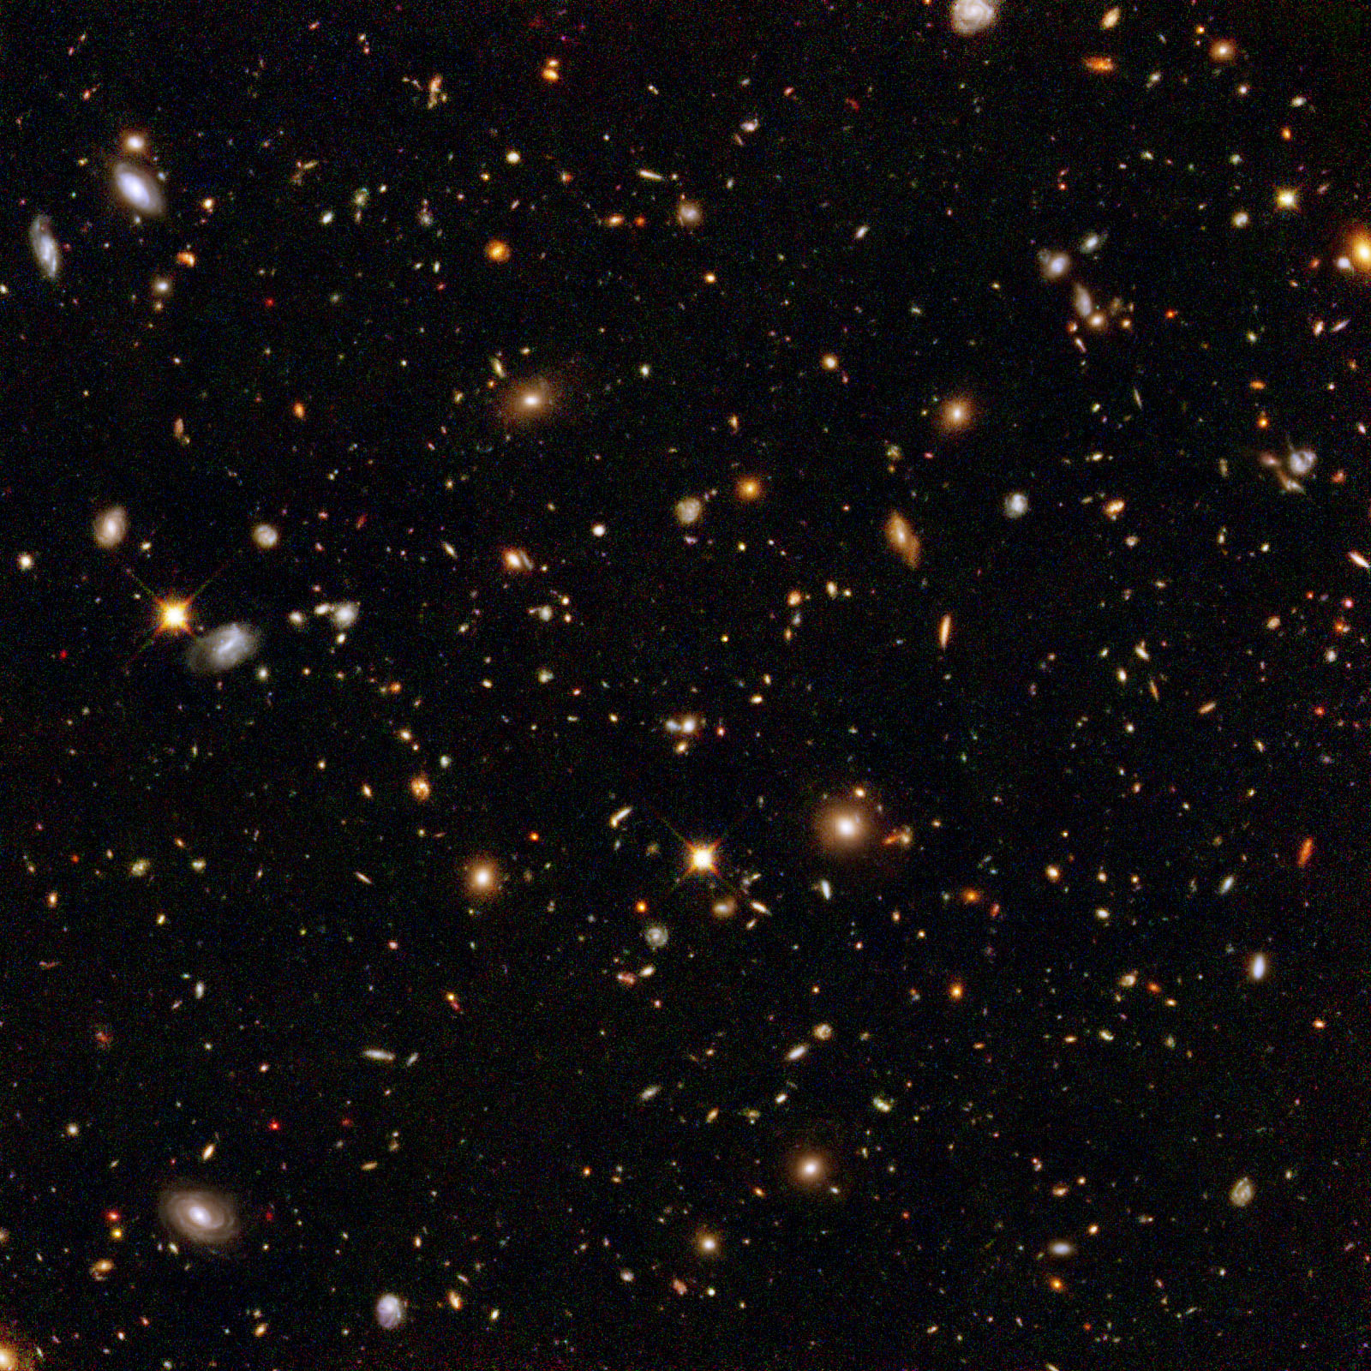
The basis of Ontological Realism (O.R.)
There is one external reality which is ‘objectively’ the way it is;
That reality is accessible to us;
We build in our brains cognitive representations of reality;
We communicate with others about what is there, and what we believe there is there.
Smith B, Kusnierczyk W, Schober D, Ceusters W. Towards a Reference Terminology for Ontology Research and Development in the Biomedical Domain. Proceedings of KR-MED 2006, Biomedical Ontology in Action, November 8, 2006, Baltimore MD, USA

Slide 11
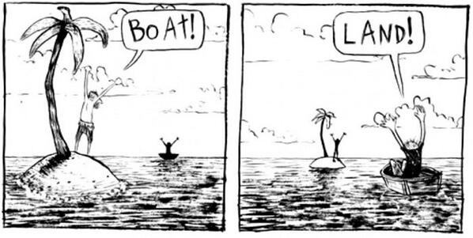
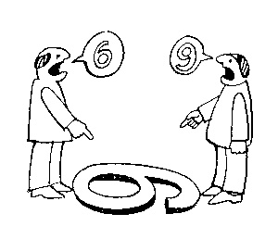
Goal: objectivity!
There are two kinds of qualities: ones that vary with the perspective one has or takes, and ones that remain constant through changes of perspective. The latter are the objective properties.
http://plato.stanford.edu/entries/scientific-objectivity

Slide 12
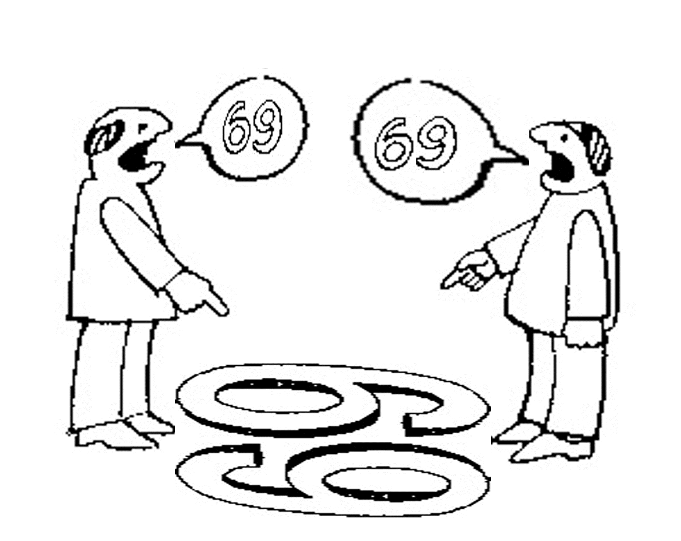
Is there scientific objectivity here?
sixty
nine
sixty
nine

Slide 13
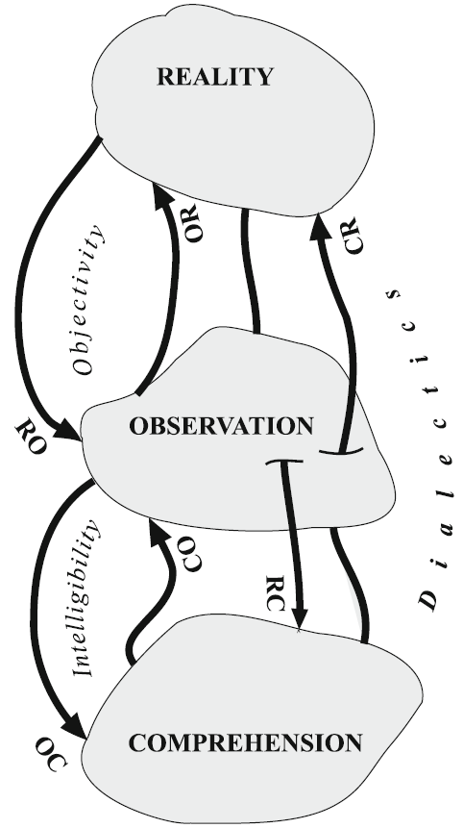
Observation / perception / comprehension
There is one external reality which is ‘objectively’ the way it is;
That reality is accessible to us;
We build in our brains cognitive representations of reality;
We communicate with others about what is there, and what we believe there is there.
Smith B, Kusnierczyk W, Schober D, Ceusters W. Towards a Reference Terminology for Ontology Research and Development in the Biomedical Domain. Proceedings of KR-MED 2006, Biomedical Ontology in Action, November 8, 2006, Baltimore MD, USA
Wagensberg, J., On the Existence and Uniqueness of the Scientific Method. Biological theory, 2014. 9(3): p. 335.

Slide 14
Perception / Observation
‘To perceive reality implies a kind of conversation between a mind and a slice of reality. The mind devises a representation of a slice of reality by using some kind of language. When the perceptions are programmed in accordance with preconceived criteria, the perception is called observation.’
‘What we call a mystical experience can be perceived, but it is very difficult to observe.’
Wagensberg, J., On the Existence and Uniqueness of the Scientific Method. Biological theory, 2014. 9(3): p. 333.

Slide 15
Interplay of reality, sensing perceiving and interpreting
 | Reality | Sensing | Perceiving | Interpreting
Canonical case | Dog | Dog-stimulus | Dog | Dog
Illusion | Dog | Cat-like stimuli | Cat | Cat / Cat? / x?
Hallucination | - | - | Dog | Dog
Belief in inaccurate perception | - | - | Dog | No dog
Delusion | - | - | - | Dog
Sensory loss | Dog | - | - | -
(visual) anosognosia | Dog | Dog-stimulus | - | Dog
Denial | Dog | Dog-stimulus | Dog | -

Slide 16
The Scientific Method
principles and procedures for the systematic pursuit of knowledge involving:
  the recognition and formulation of a problem,
  the collection of data through observation and experiment, and
  the formulation and testing of hypotheses.
http://www.merriam-webster.com/dictionary/scientific%20method

Slide 17
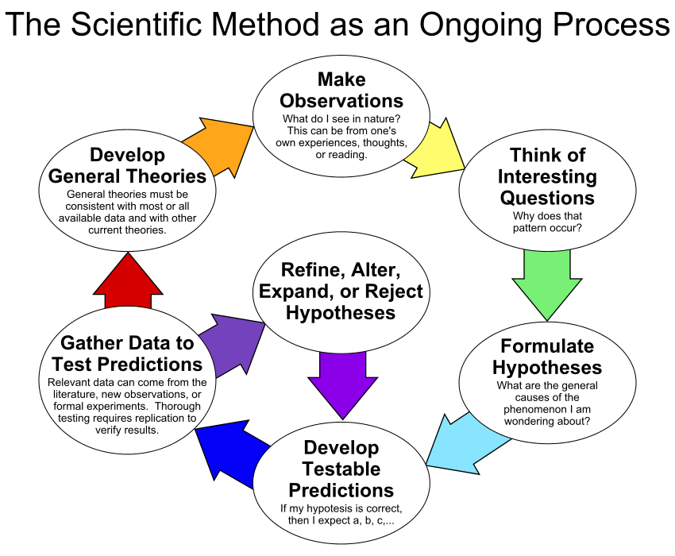
By ArchonMagnus - Own work, CC BY-SA 4.0, https://commons.wikimedia.org/w/index.php?curid=42164616

Slide 18
Level of evidence ←→ Type of study
From low to high evidence:
Descriptive
Exploratory
Hypothesis/theory search
Comparative
Controlled trial (require experiment)
Systematic review

Slide 19
Some key principles in how to do science
Objective observation: measurement and data (possibly although not necessarily using mathematics as a tool),
Evidence,
Experiment and/or observation as benchmarks for testing hypotheses,
Induction: reasoning to establish general rules or conclusions drawn from facts or examples,
Repetition,
Critical analysis,
Verification and testing: critical exposure to scrutiny, peer review and assessment.
http://sciencecouncil.org/about-us/our-definition-of-science/

Slide 20
Identifying pseudoscience
Belief in authority: It is contended that some have a special ability to determine what is true or false. Others must accept their judgments.
Unrepeatable experiments: Reliance is put on experiments that cannot be repeated by others with the same outcome.
Handpicked examples: are used although they are not representative of the general category that the investigation refers to.
Unwillingness to test: A theory is not tested although it can be.
Disregard of refuting information: Observations or experiments that conflict with a theory are neglected.
Built-in subterfuge: The testing of a theory is so arranged that the theory can only be confirmed, never disconfirmed, by the outcome.
Explanations are abandoned without replacement. Tenable explanations are given up without being replaced, so that the new theory leaves much more unexplained than the previous one.
Hansson, Sven Ove, "Science and Pseudo-Science", The Stanford Encyclopedia of Philosophy (Spring 2015 Edition), Edward N. Zalta (ed.). https://plato.stanford.edu/archives/spr2015/entries/pseudo-science/.

Slide 21
Arguments versus opinions

Slide 22
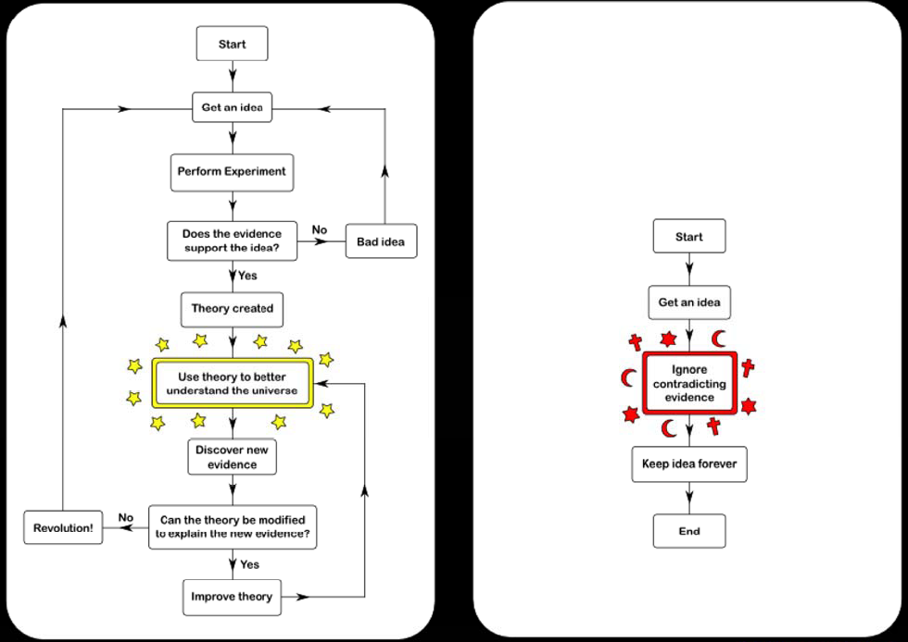
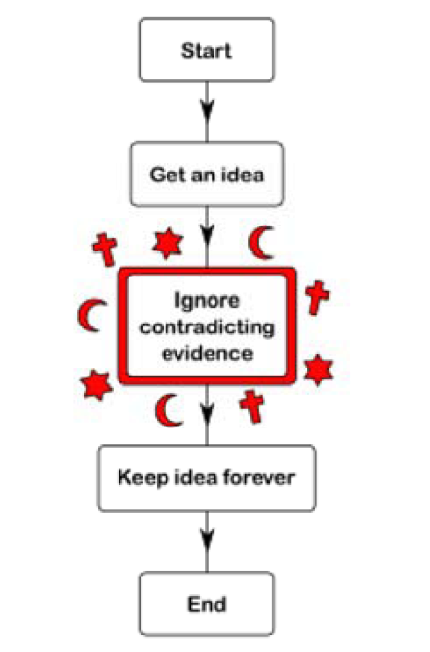
Science
Argument
Faith
Opinion
https://rationalwiki.org/wiki/Scientific_method

Slide 23
Roughly …
‘An argument involves arriving at a judgement which is based on an evaluation of relevant ideas and evidence’.
‘An opinion, on the other hand, is a point of view formed without sufficient evidence to support it. It tends to reflect an individual's instinctive reactions and personal experience’.
However: it is perfectly possible to back up opinions by means of arguments. → ‘opinion papers’.
  where science is not established,
  discussion about alternative methods.
https://www.bradford.ac.uk/t4-ssis/ruski-files/academic-voice/page_07.htm

Slide 24
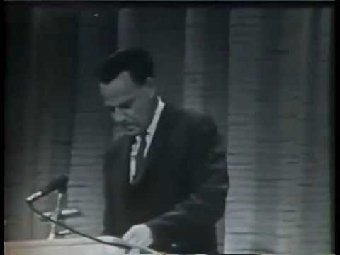
There is place for opinion in science
https://www.youtube.com/watch?v=NM-zWTU7X-k

Slide 25
Deduction and induction (1)
A deductive argument is an argument that is intended by the arguer to be (deductively) valid, that is, to provide a guarantee of the truth of the conclusion provided that the argument's premises (assumptions) are true.
http://www.iep.utm.edu/ded-ind/

Slide 26
Valid and sound (deductive) arguments
A deductive argument is said to be valid if and only if it takes a form that makes it impossible for the premises to be true and the conclusion nevertheless to be false. Otherwise, a deductive argument is said to be invalid.
A deductive argument is sound if and only if it is both valid, and all of its premises are actually true. Otherwise, a deductive argument is unsound.
http://www.iep.utm.edu/val-snd/

Slide 27
Deduction and induction (2)
A deductive argument is an argument that is intended by the arguer to be (deductively) valid, that is, to provide a guarantee of the truth of the conclusion provided that the argument's premises (assumptions) are true.
An inductive argument is an argument that is intended by the arguer merely to establish or increase the probability of its conclusion. In an inductive argument, the premises are intended only to be so strong that, if they were true, then it would be unlikely that the conclusion is false.
http://www.iep.utm.edu/ded-ind/

Slide 28
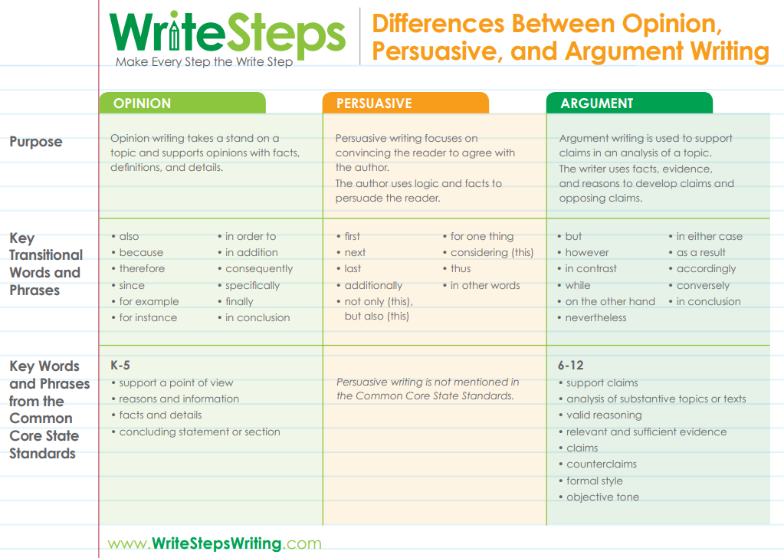

Slide 29
There is science and reporting on science

Slide 30
The Scientific Method
principles and procedures for the systematic pursuit of knowledge involving:
  the recognition and formulation of a problem,
  the collection of data through observation and experiment, and
  the formulation and testing of hypotheses.
http://www.merriam-webster.com/dictionary/scientific%20method

Slide 31
There is science and reporting on science
Science can be done correctly, but important information missing in the report about the science.
Science can be done inadequately, but report is written so as to hide the flaws.
When assessing a paper, you need to check for both!

Slide 32
Some characteristics of good scientific papers
An important problem is addressed.
A methodological literature study has been performed to assess the state of the art wrt the problem.
A novel hypothesis relevant to the problem is formulated or a previous hypothesis challenged.
It is explained how data needed to accept or reject the hypothesis are collected, and why these data are able to fulfil that purpose.
Statistical tests used, if any at all, are appropriate for accepting or rejecting the hypothesis.
When possible or within scope, test experiments are conducted.
Findings are explained, conclusion thoroughly motivated.
Assessment of points 2 to 7 bear no indications for pseudoscience.
Limitations of the methodology or findings are indicated.
Directions for future research to resolve limitations are suggested.

Slide 33
Assignment A3
Apply to paper R2 (https://www.ncbi.nlm.nih.gov/pmc/articles/PMC7388036/ ) the principles and criteria for scientific research and reporting as explained.
Write a short scientific report of exactly 1 page (Times New Roman 10 points, margins 1 inch, single line spacing) on the extent to which this paper exhibits the desired criteria.
State for each criterion whether the paper does or does not satisfy it, and give a succinct argument for why that is.
Email your Word-document to wceusters@gmail not later than Monday Sept 21 – 9AM.

